Slide 1
Minecraft Modding/Java Basics
GitHub
Java: Classes and Variables

Slide 2
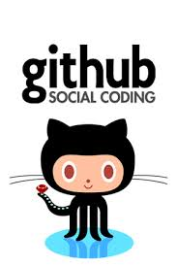
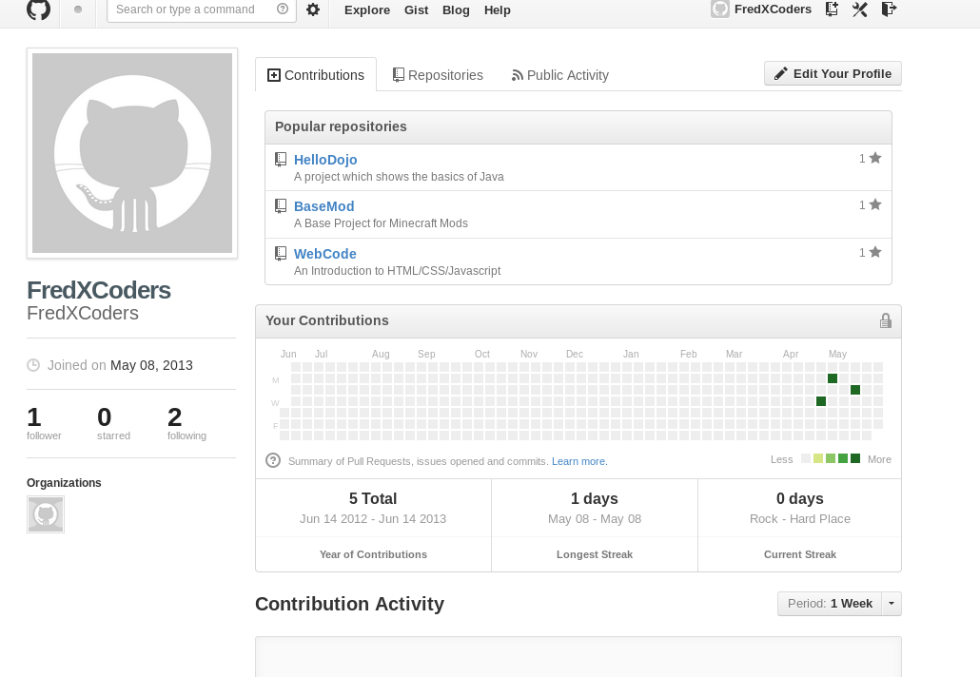

GitHub
Server
Local
Notes:
I'm going to teach you how to use two of our sites in one.
Does anybody remember what we're going to use GitHub for? (Storing our code)
GitHub is our Source Repository. This is where we store our source code.

Slide 3

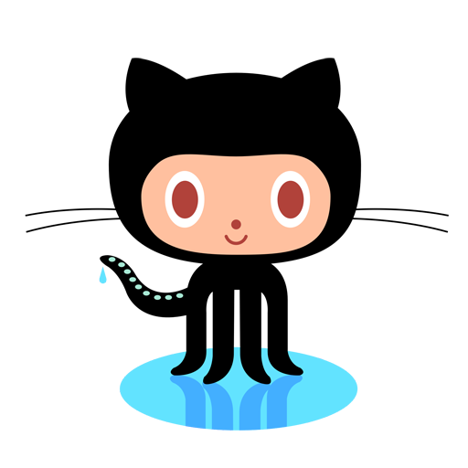
Git Terms
Repository – A place to store code for a project
Clone – Copies a repository to your computer
Pull – “Pull” code which has changed in a repository to your local computer
Push - “Push” code which you have changed locally to it's repository
Notes:
Git is the system GitHub uses to keep track of changes in our code. There are different kinds of systems to keep track of code. Another popular one is Subversion.

Slide 4
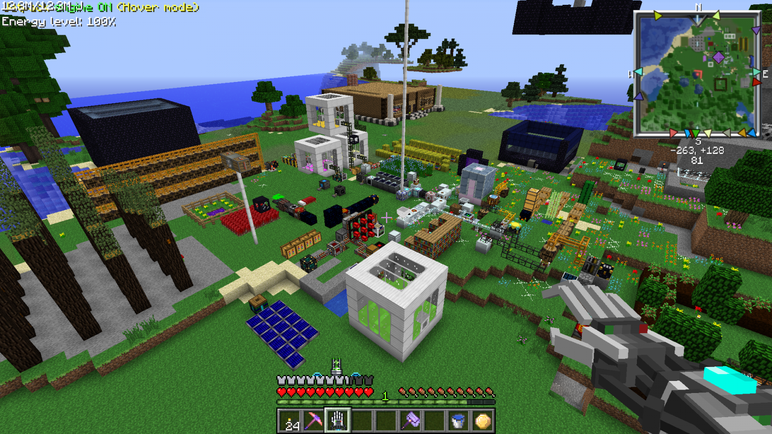
Minecraft Mods: How do they Work?
Mod files put in myMod.jar
Mod files are taken out of
myMod.jar and put in
minecraft.jar
Minecraft reads the mod files when it's loading
Forge automates this for us!
Notes:
Do you know what a .zip file is? A jar is just a zip file (except it's called jar). Java uses these to hold files together.
Show opening a mod jar
Show opening minecraft jar
Show forge files

Slide 5
Java: Classes
package com.fredxcoders.dojo.example;
import java.util.Date;
public class HelloDojo1 { //classes must be contained by '{' and '}'
public static void main(String[] args) { //Methods also must be contained by '{' and '}'
Date rightNow = new Date(); //This is a "statement". Statements must end with a ';'.
System.out.println("Hello Dojo! Here's the current time: " + rightNow.toString());
}
}
Class
Method
Statement
Notes:
You're going to see a lot of things you don't understand. That's ok! Who in here knows everything about the English language? Including every word? If you didn't know an English word what would you do? (Dictionary, Google). That's a great resource for code too! I Google code questions every day at work.
Remember: classes are made up of methods and variables. Methods “do stuff” and variable “hold information”
What do you think this class will do if we run it? Run it and find out!

Slide 6
Java: Syntax
There are rules to writing code for a language.
  What are some rules when writing English?
Statements are like sentences. They must end in a semicolon ( ; )
Periods ( . ) let you use an object's methods
Methods must wrap their statements in curly brackets ( { } )
Comments start with two forward slashes ( // )
Notes:
Remember “reading” code? Code has rules like English
Here are some important rules for Java Syntax:

Slide 7
Java: Variables
int myNumber = 42;
String message2 = "Another message that comes from a String variable”;
Date rightNow = new Date();
Notes:
What syntax rules do you see here?
Different types of variables can hold different information
If you had to guess, what do you think the variable types are here? (int (short for Integer), String, Date)
There are different ways to set the value of variables
- Int here is the simplest, just use the number!
- String is also pretty easy, just wrap your string with quotes
- Date is more tricky. It's a more complicated type and we use the word “new” to define a new Date object

Slide 8
Java: Variables (Arrays)
public String[ ] myStringArray = new String[3];
myStringArray[0] = "Hello";
myStringArray[1] = "Coder";
myStringArray[2] = "Dojo";
Could look like this: { “Hello”, “Coder”, “Dojo” }
public String[ ][ ] myStringArray = new String[3][3];
Notes:
An array can hold multiple objects in one variable.
Who can tell me the name of this array variable?
The first statement creates a new array (myStringArray).
How many Strings does this variable hold? Let's see.
(Show statements) Three elements. Does anyone see anything weird about how we're storing our strings in the array? (Starts with 0). This is the Index of the array. In many programming languages an array's index starts at 0.
This is a good way to think about the elements in the array.
We can also have “multi-dimentional” arrays (they do not involve time travel). This is a 3 x 3 array (draw on board.) What does this remind you of? (draw lines like a crafting table)

Slide 9
BaseMod: RecipeHelper
Recipe[][] recipe =
{ { “cobblestone”, “cobblestone”, “cobblestone” },
{ “cobblestone”, “ ”, “cobblestone” },
{ “cobblestone”, “cobblestone”, “cobblestone” } };
recipe[0][0]
vertical
Horizontal
Notes:
Time to get back to Minecraft! What do you think a class called RecipeHelper does? (Adds custom recipes in our mod.)
This array could be representing what recipe? (Furnace)
In eclipse switch back to your other (Minecraft) workspace. Find the file BaseMod.java and open it.
Notice our recipe is making dirt into dirt. Delete the word dirt and hit ctrl + enter. Choose a new item to make!

